Slide 1
EduNexus
Virtual Classroom Reminder App
CS519
Roll Number: BC230209354
Project Supervisor: Ms. Noureen Hameed

Slide 2
Overview of Technologies
Front-End Technologies:
HTML:
To prepare structure of web pages (e.g., headers, paragraphs, links, forms, etc.). And provide the basic layout and content.
CSS:
To style the structure to make the web pages look appealing. And Is responsible for color schemes, fonts, spacing, and responsive layouts.
JavaScript:
To add interactivity to the site (e.g., dynamic course lists, real-time form validation).

Slide 3
Overview of Technologies
Back-End Technologies:
PHP:
Server-side scripting for handling logic such as user authentication, course creation, and assignment management.
To handle form submissions, database queries, and dynamic page rendering.
Database and Server:
XAMPP:
Local server environment used to run the PHP code, MySQL database, and Apache server on the computer.
To include MySQL for storing course information, assignments, grades, etc.
Apache:
Web server that processes the PHP code and serves the website to the user.
To handle HTTP requests and serves content.

Slide 4
Actors
Admin: Full access to manage the platform.
Teacher: Can manage their own students, assignments, and calendar.
Student: Can view assignments, interact with classmates, and manage personal profiles.

Slide 5
Relationships Between Classes:
Admin -> Teacher: Admin can manage teachers (add/remove).
Admin -> Student: Admin can manage students (add/remove).
Teacher -> Course: Teacher can create and manage courses.
Teacher -> Student: Teacher enrolls students into courses.
Teacher -> Assignment: Teacher creates assignments for courses.
Student -> Course: Student can enroll in courses and view course content.
Student -> Assignment: Student can submit assignments for grading.
Student -> Grade: Students can view their grades for assignments.
Course -> Content: Courses have content such as lectures, notes, videos, etc.
Course -> Assignment: Courses have assignments that students can complete.
Discussion -> Student: Students can participate in discussions.

Slide 6
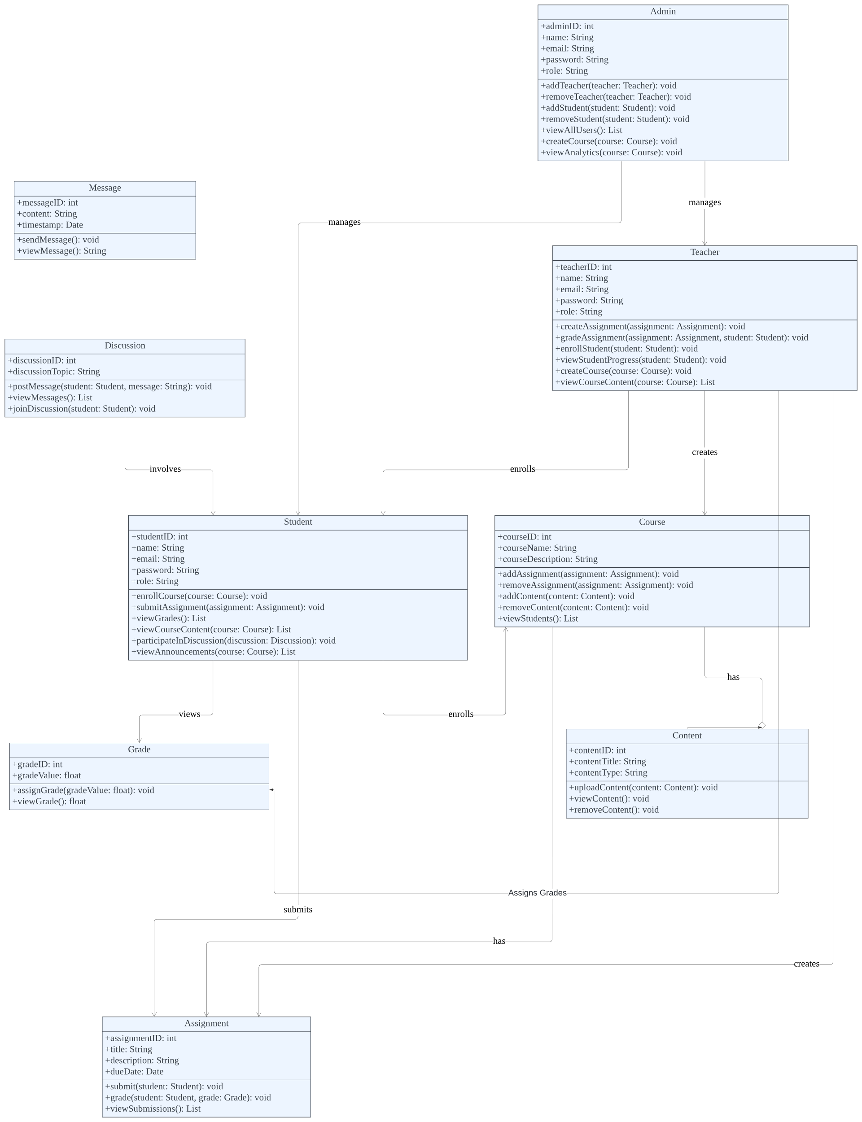
USE CASE DIAGRAM

Slide 7
Admin Use Case

Slide 8
Teachers Use Case

Slide 9
Students Use Case
Students cannot register themselves, only teachers and admins can add students to a specific course.

Slide 10
Courses Class

Slide 11
Assignments Class

Slide 12
Grades Class

Slide 13
Message Class

Slide 14
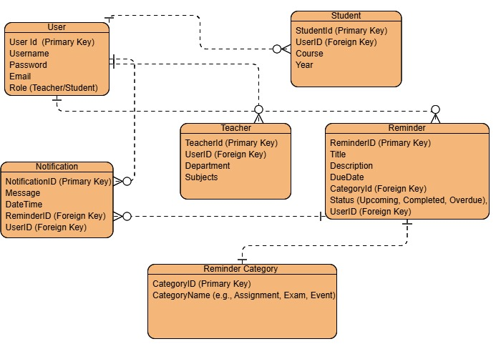
ERD

Slide 15
Features and Screenshots

Slide 16
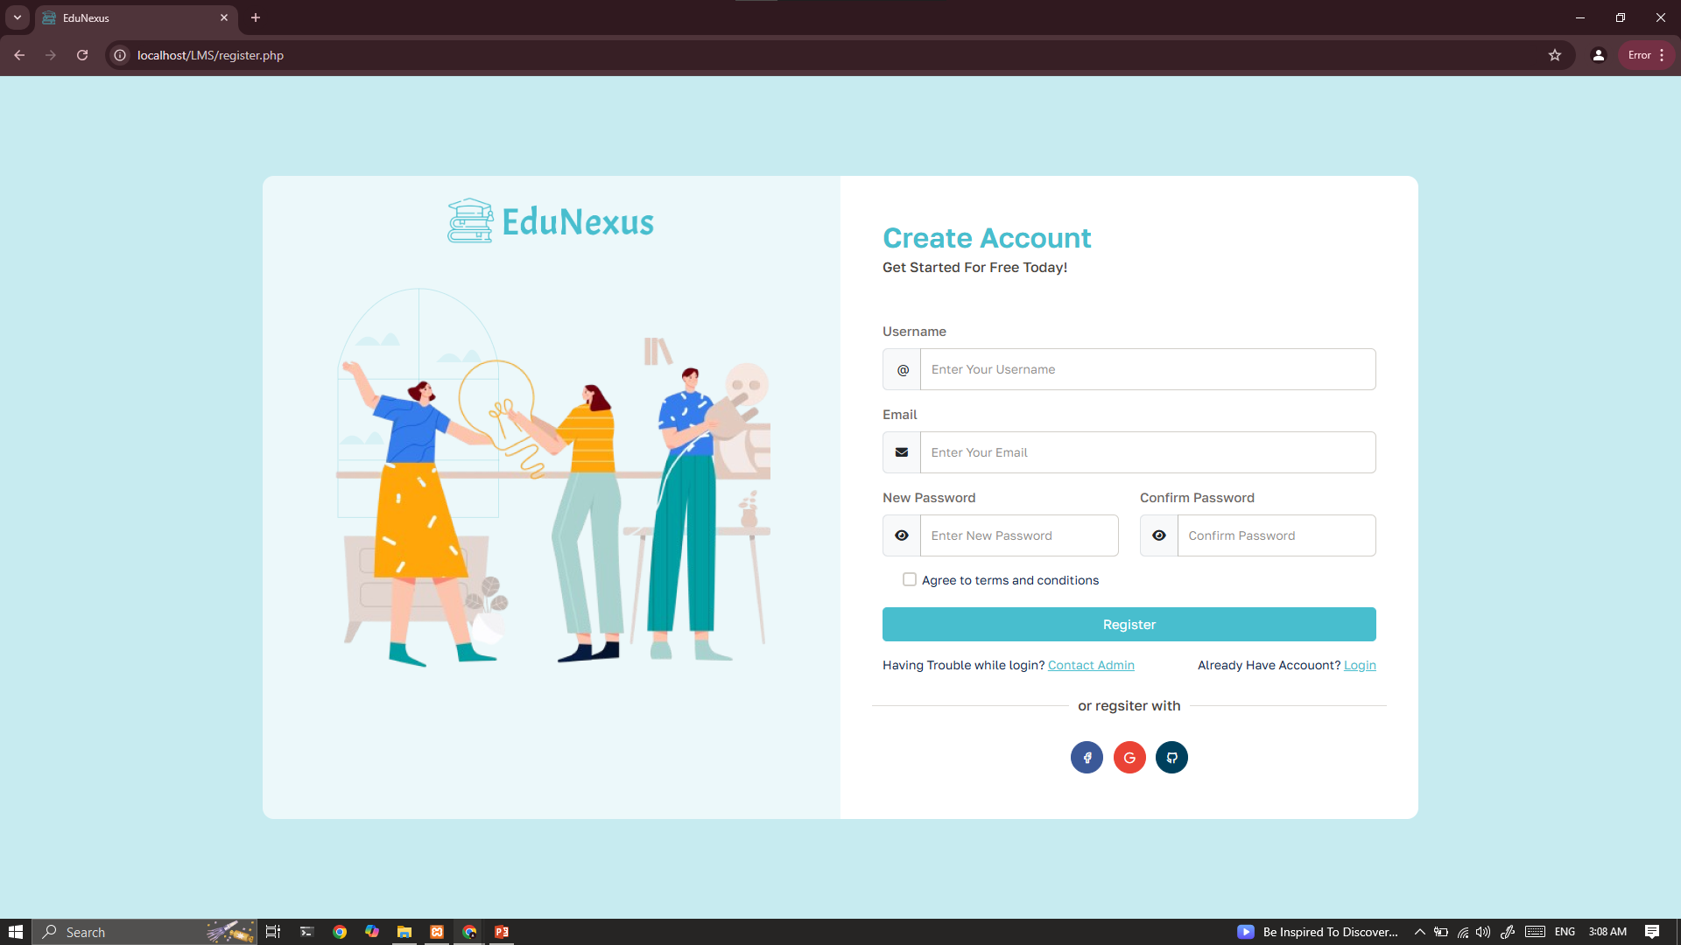

Slide 17
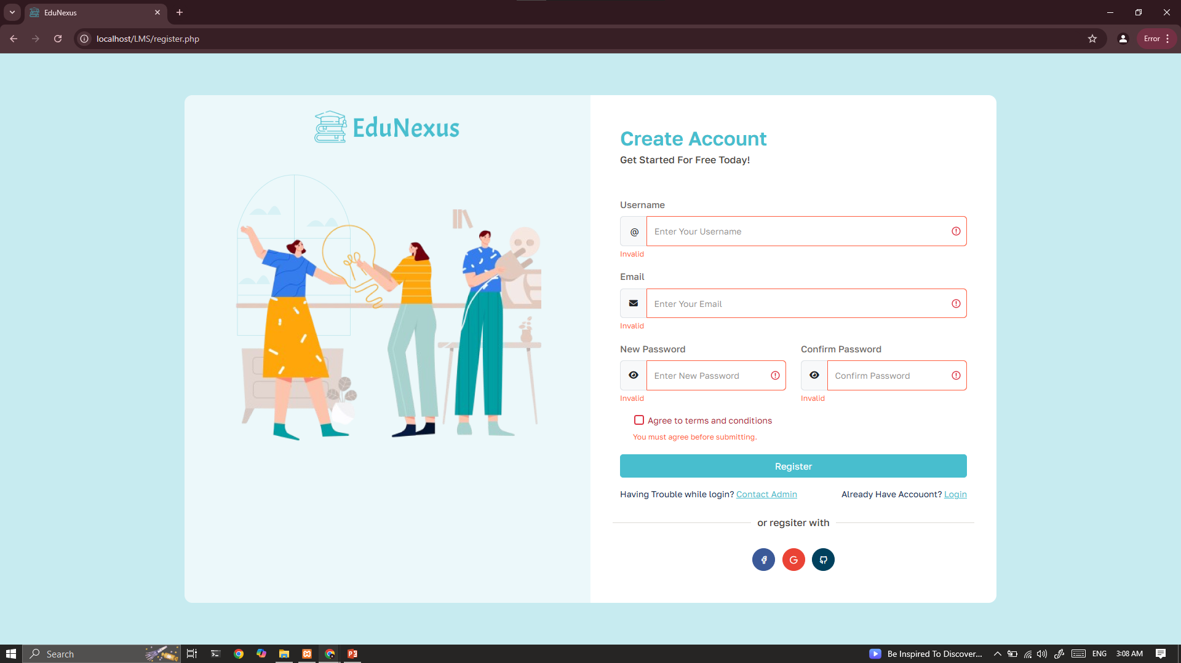

Slide 18


Slide 19
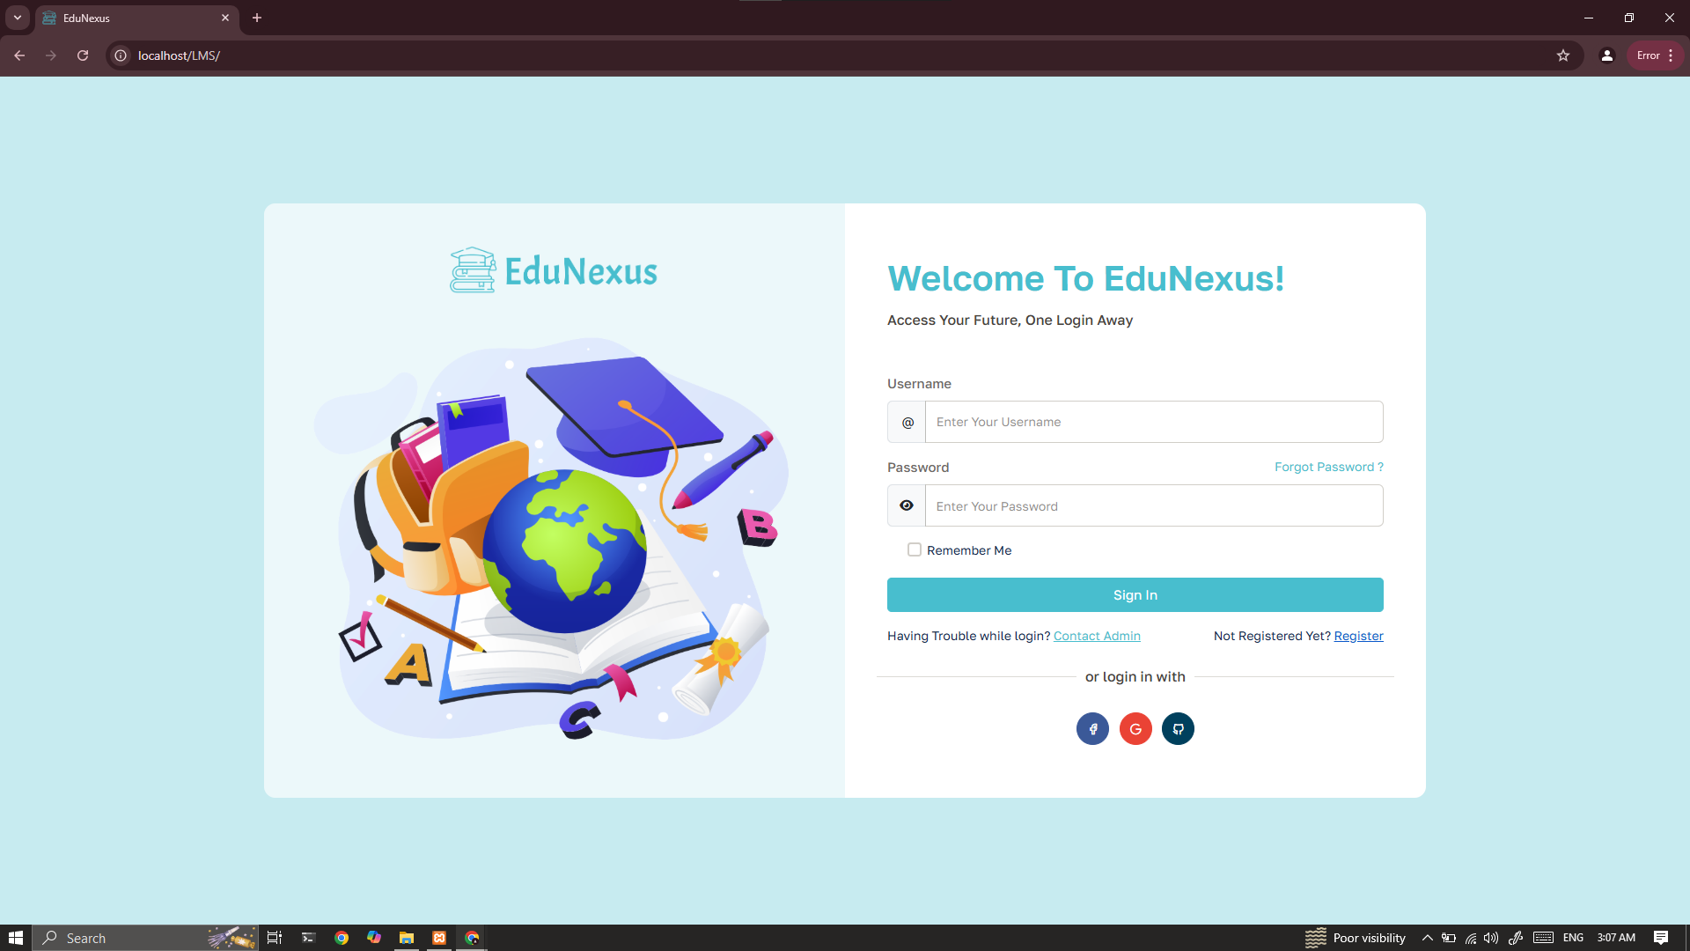

Slide 20


Slide 21
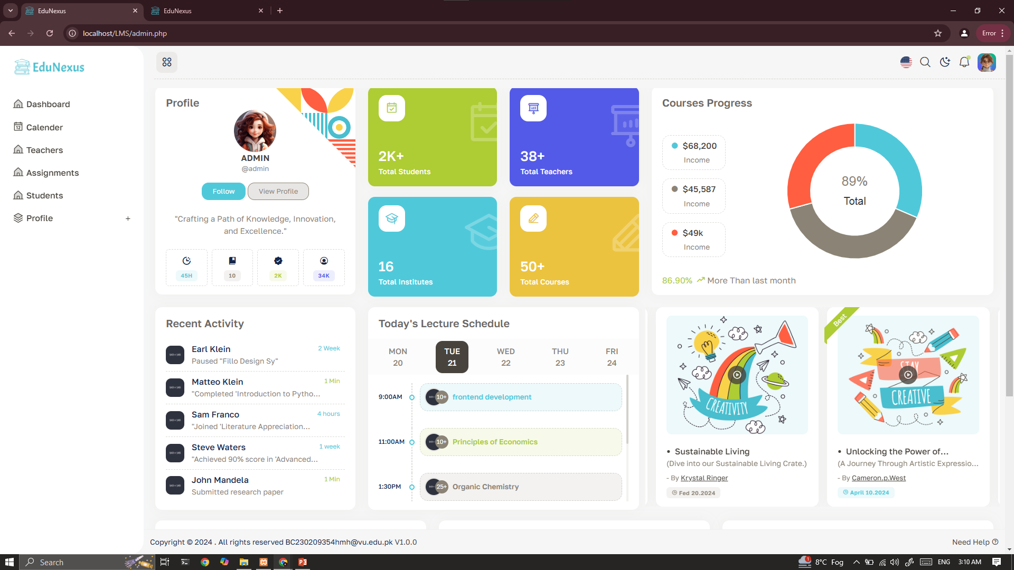

Slide 22
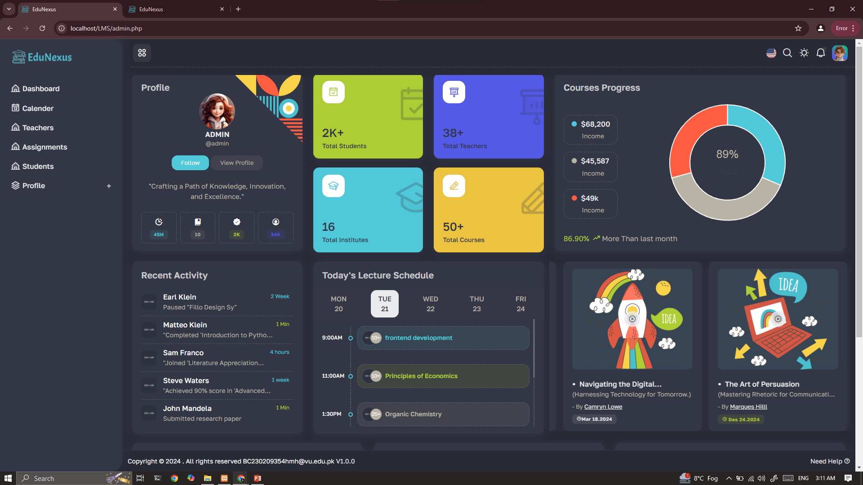

Slide 24
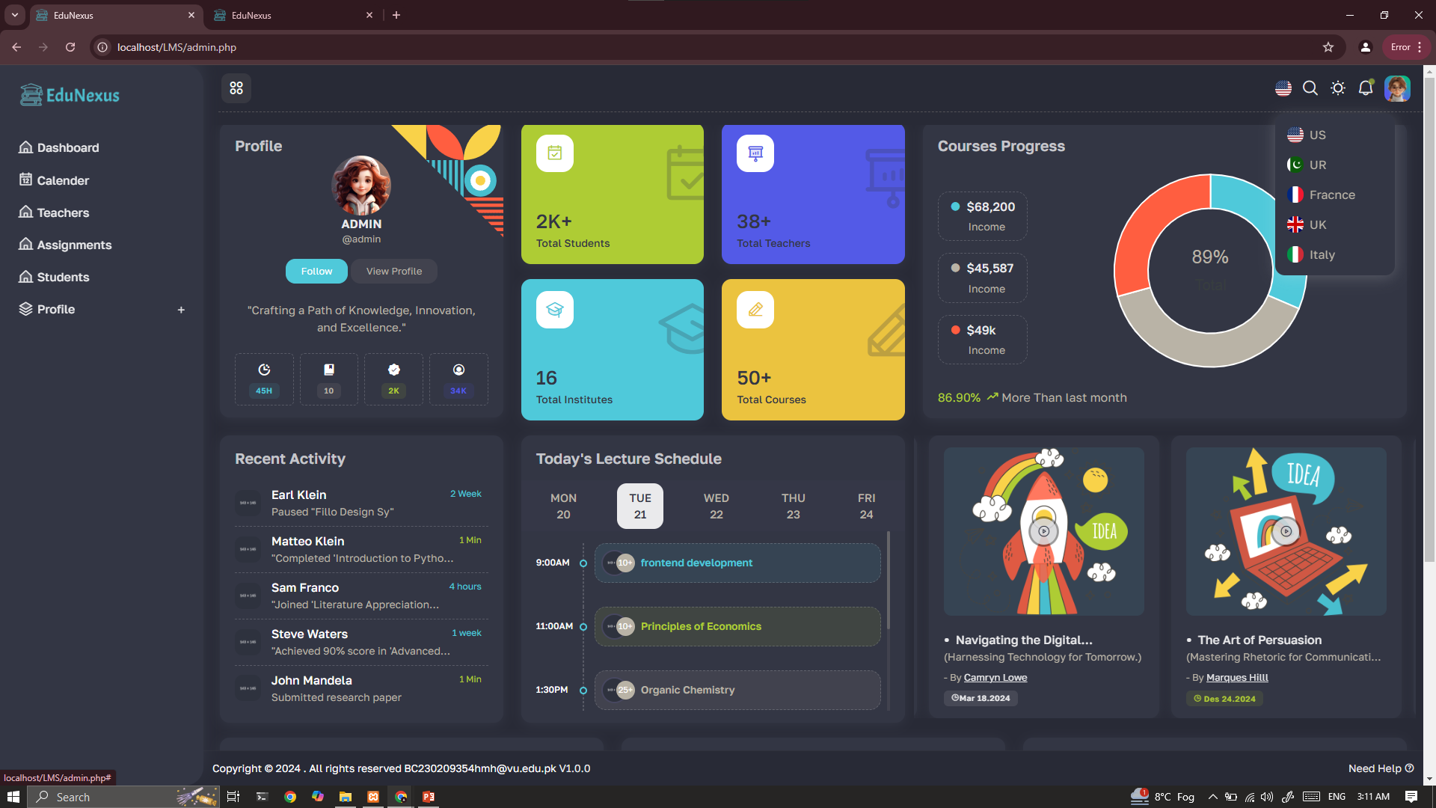

Slide 25
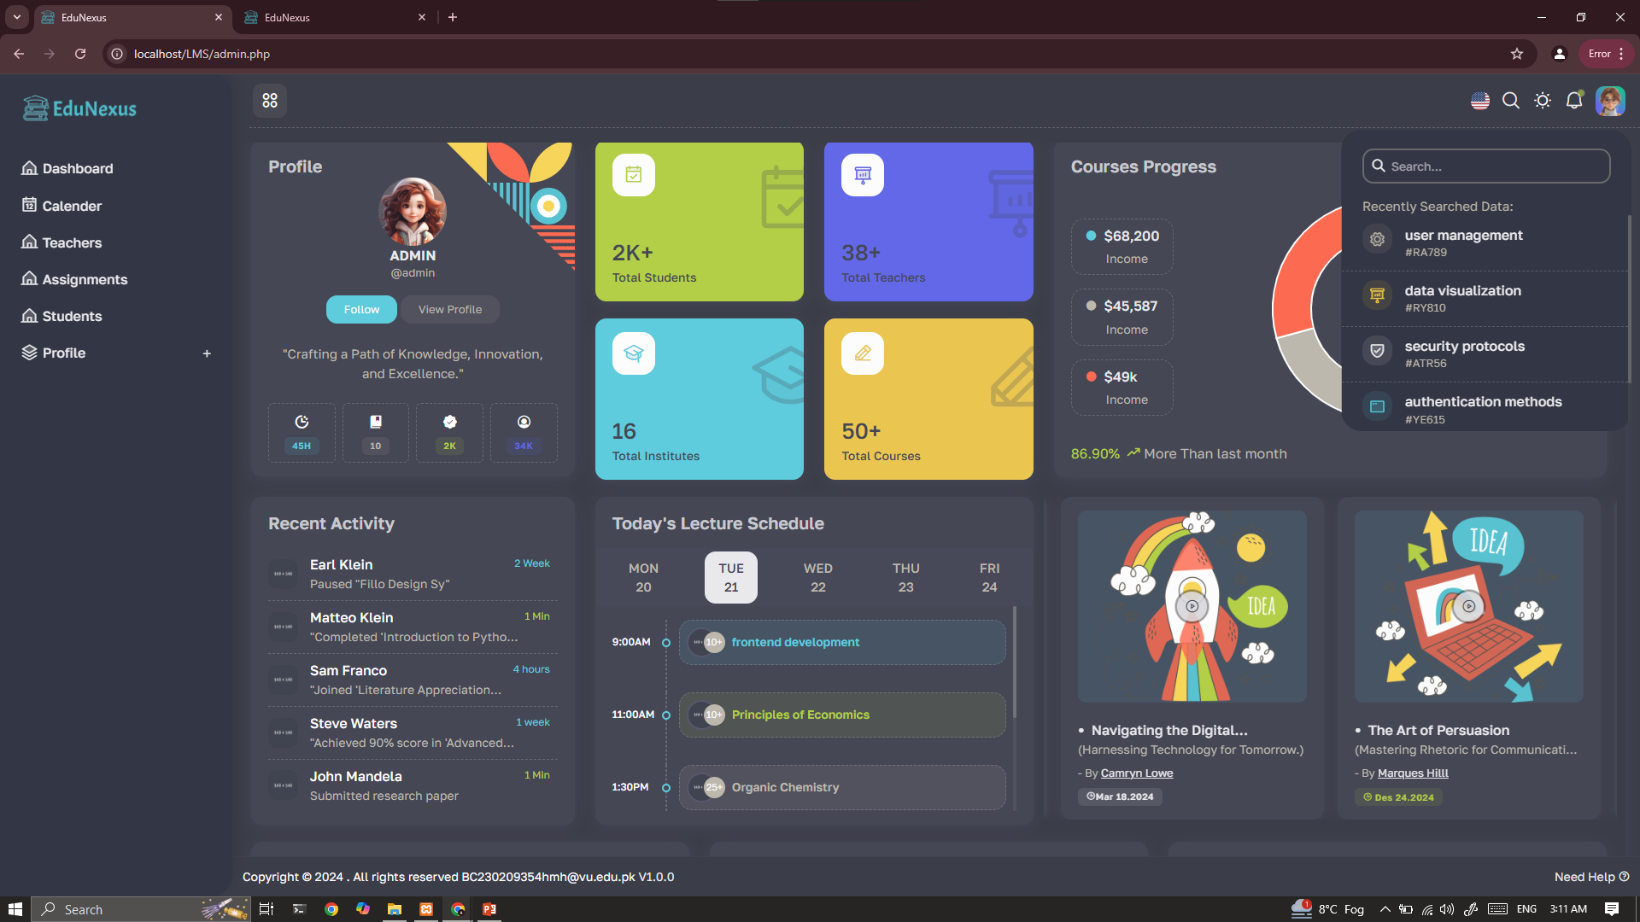

Slide 26
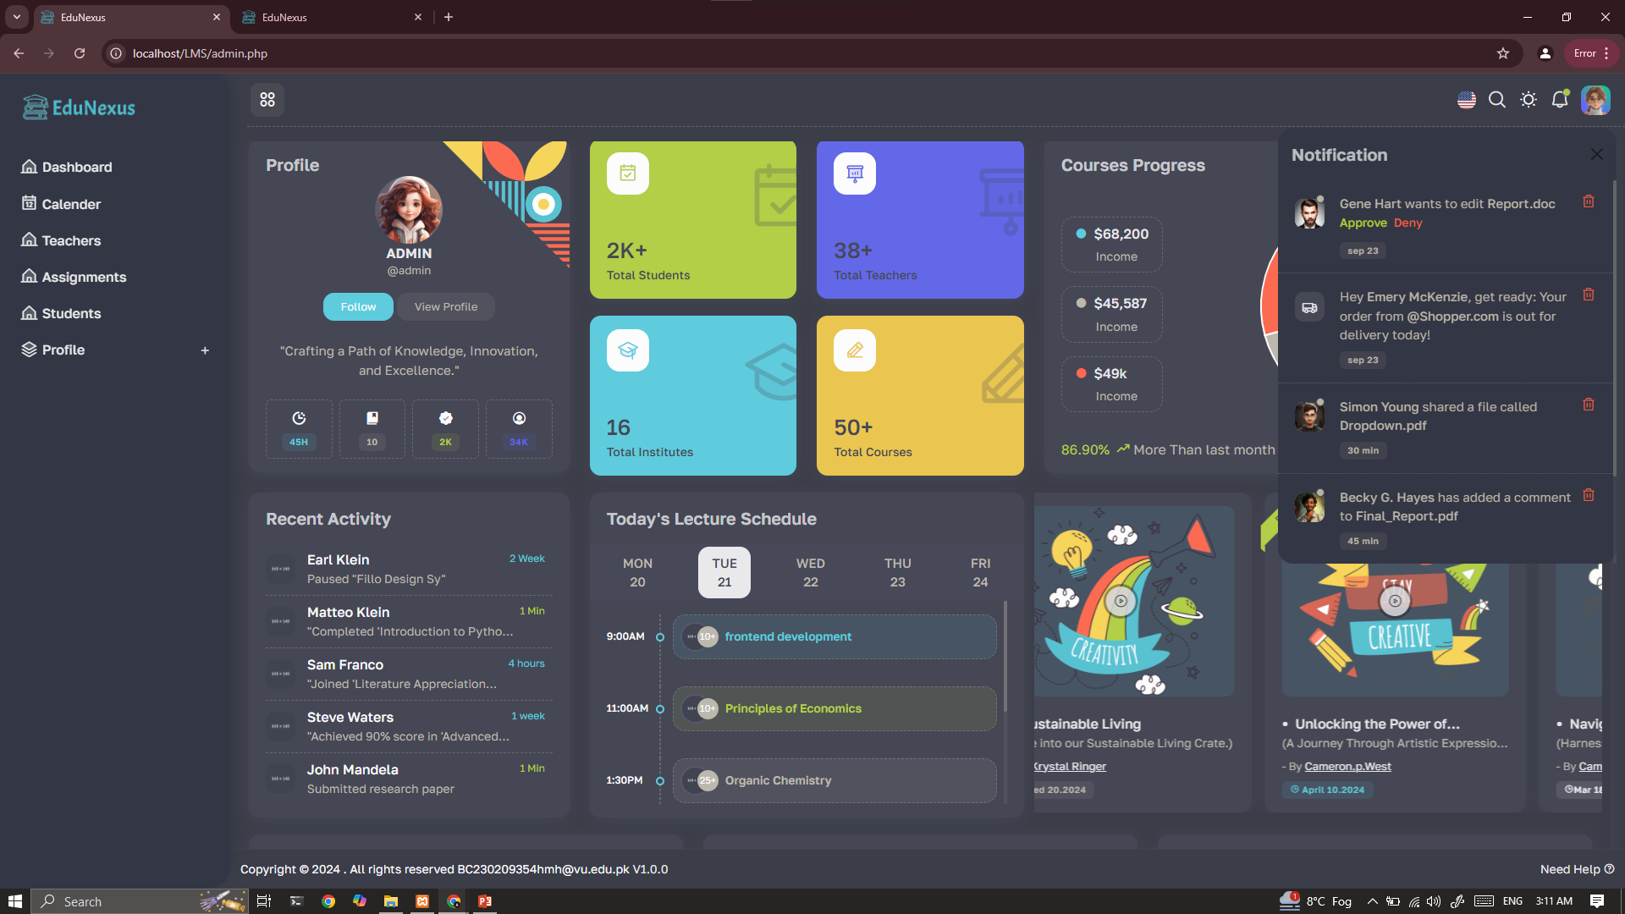

Slide 27
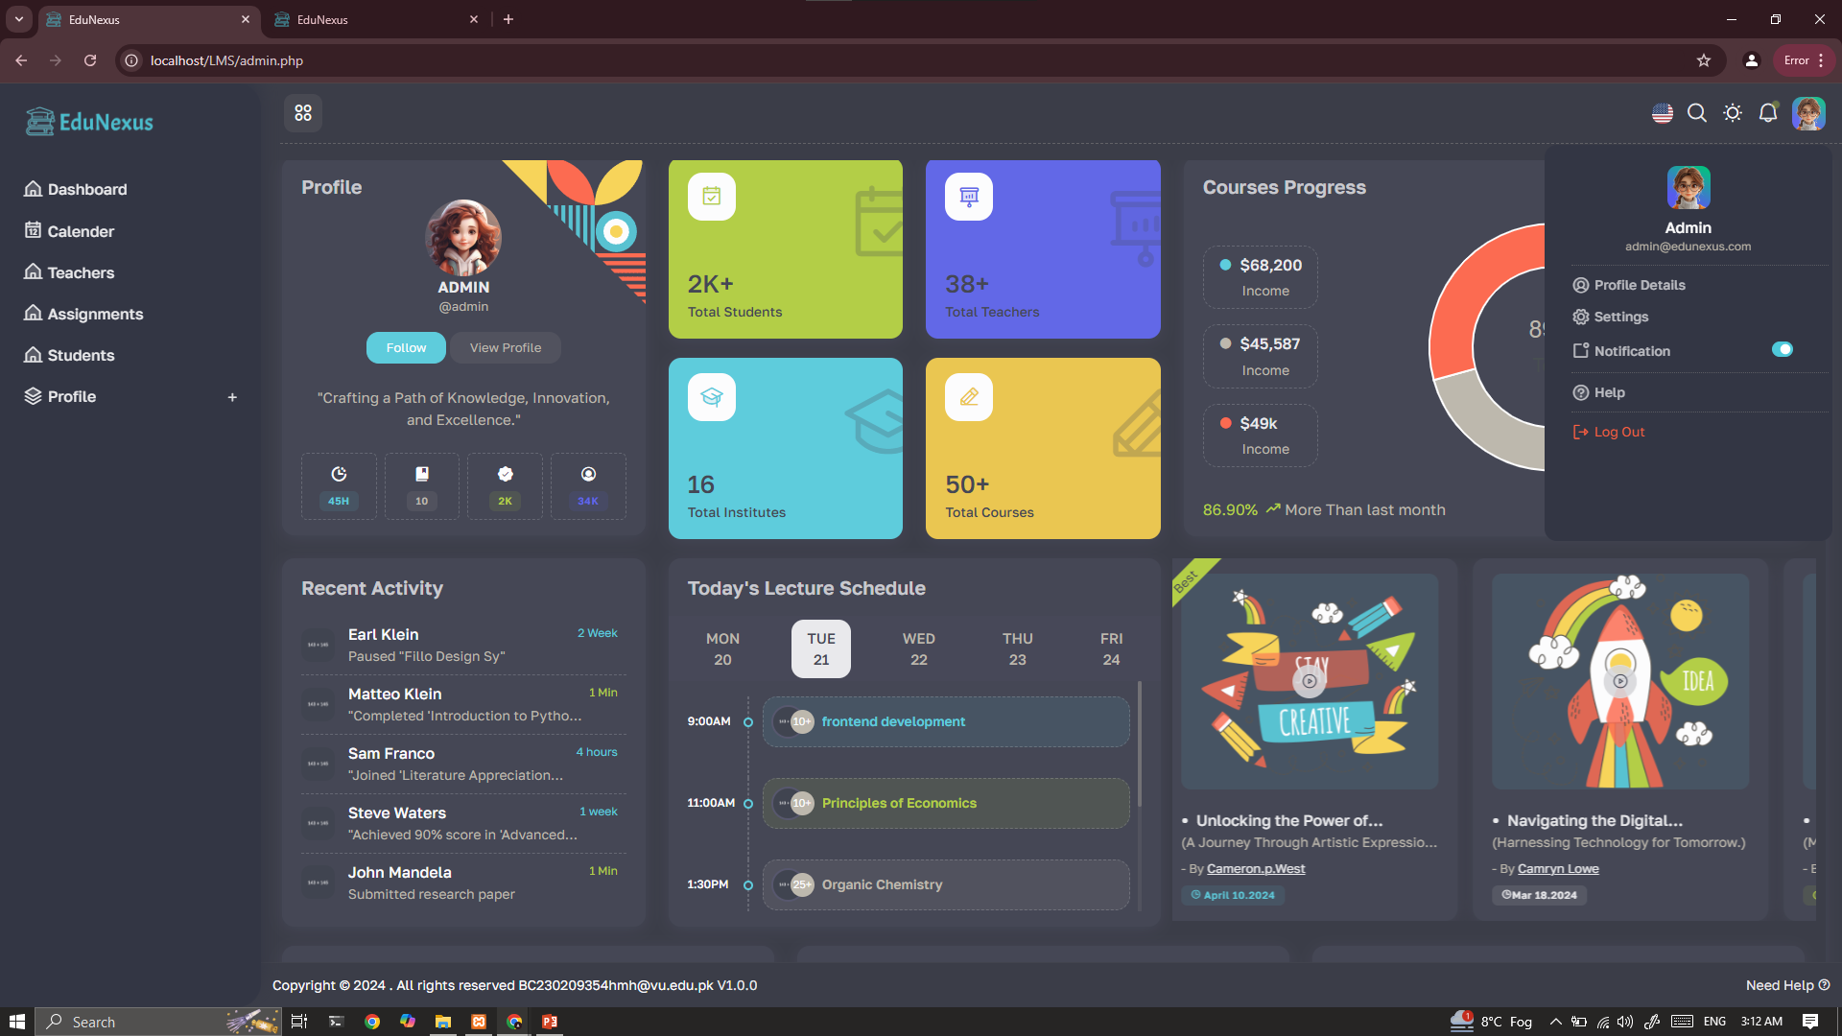

Slide 28
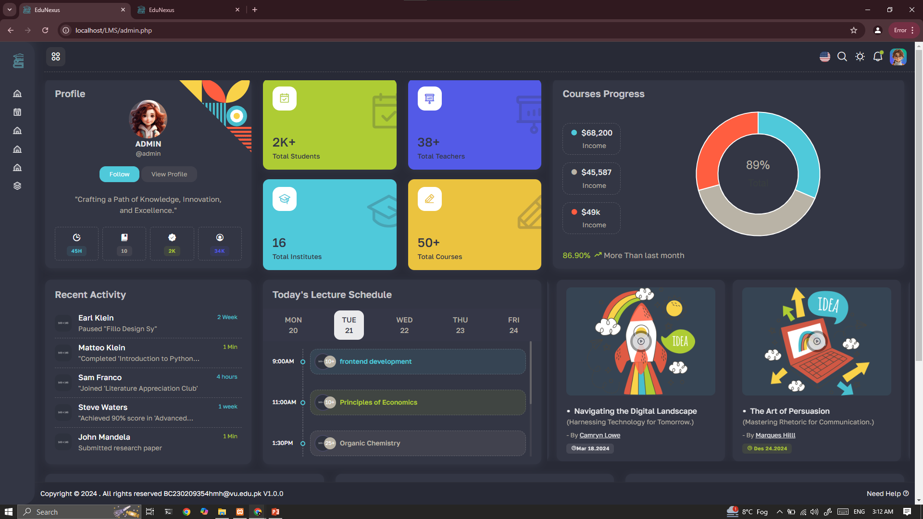

Slide 29


Slide 30
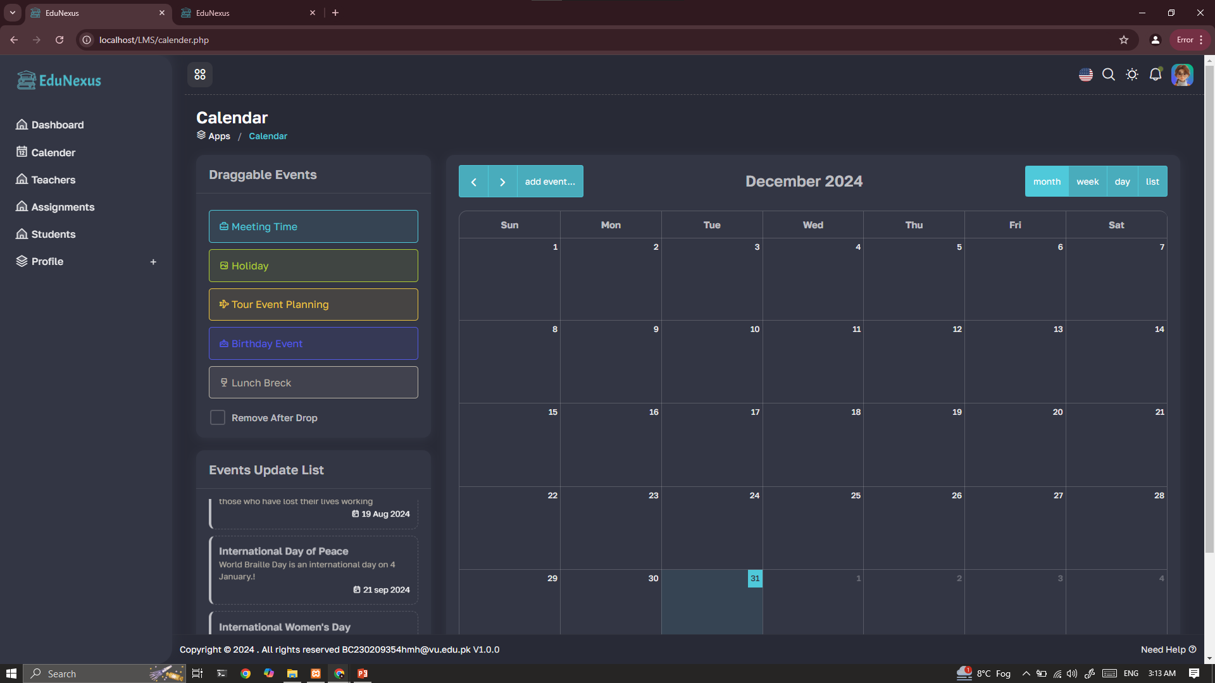

Slide 31
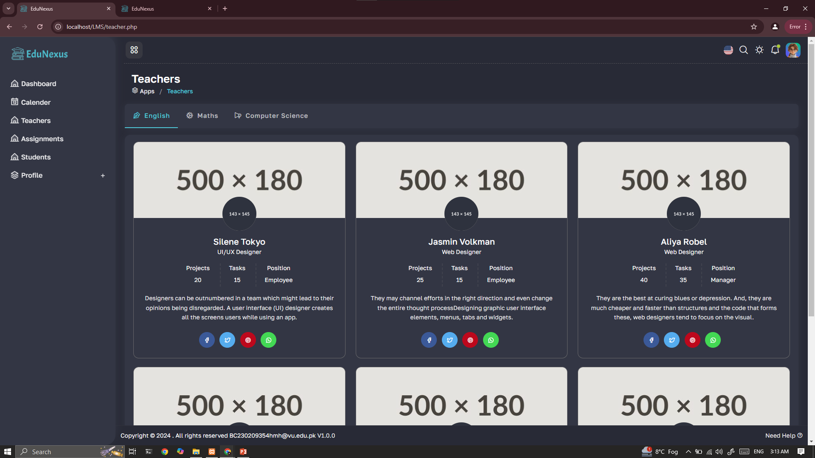

Slide 32
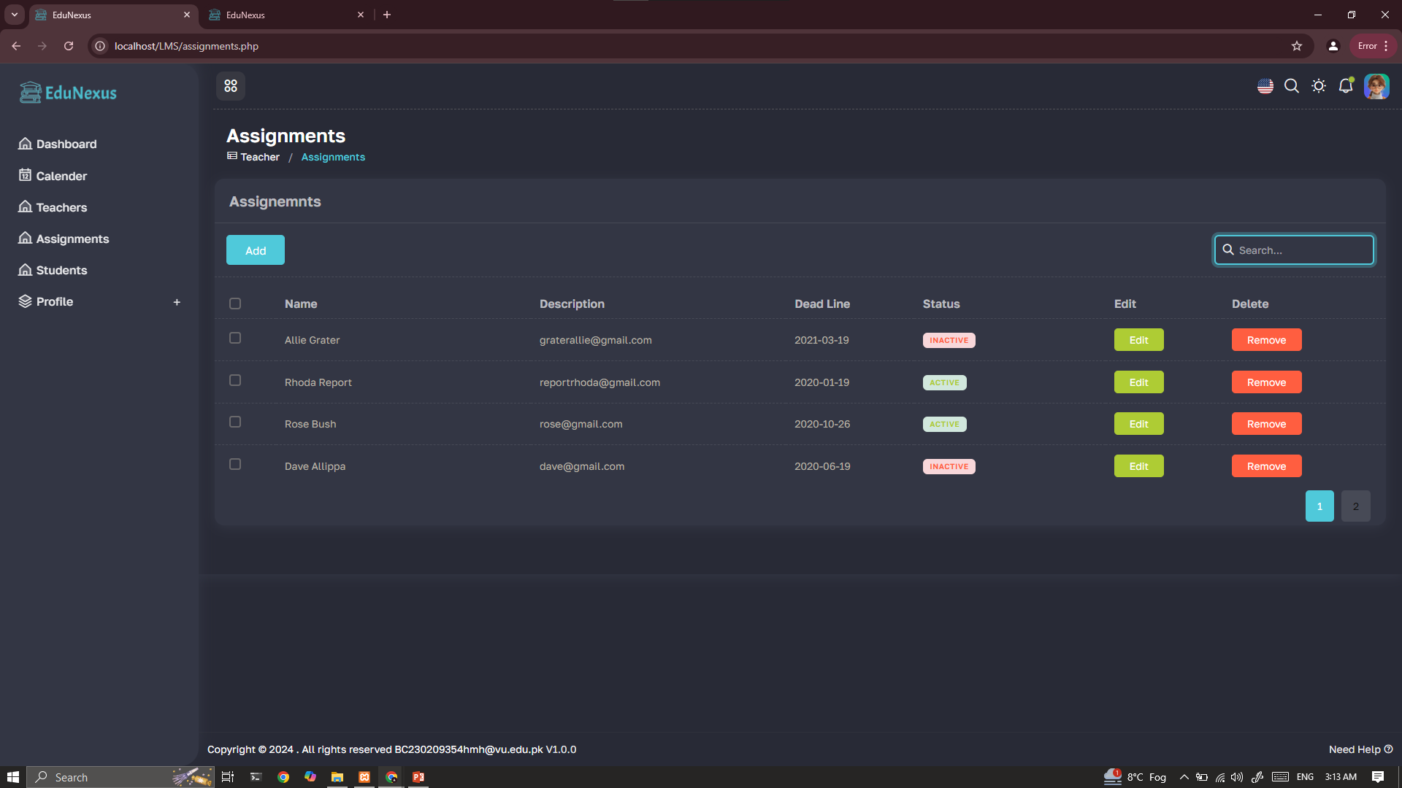

Slide 33


Slide 34
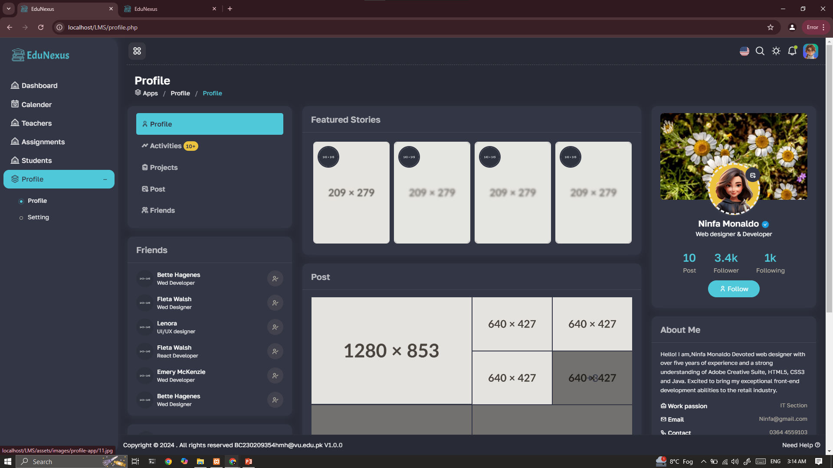

Slide 35
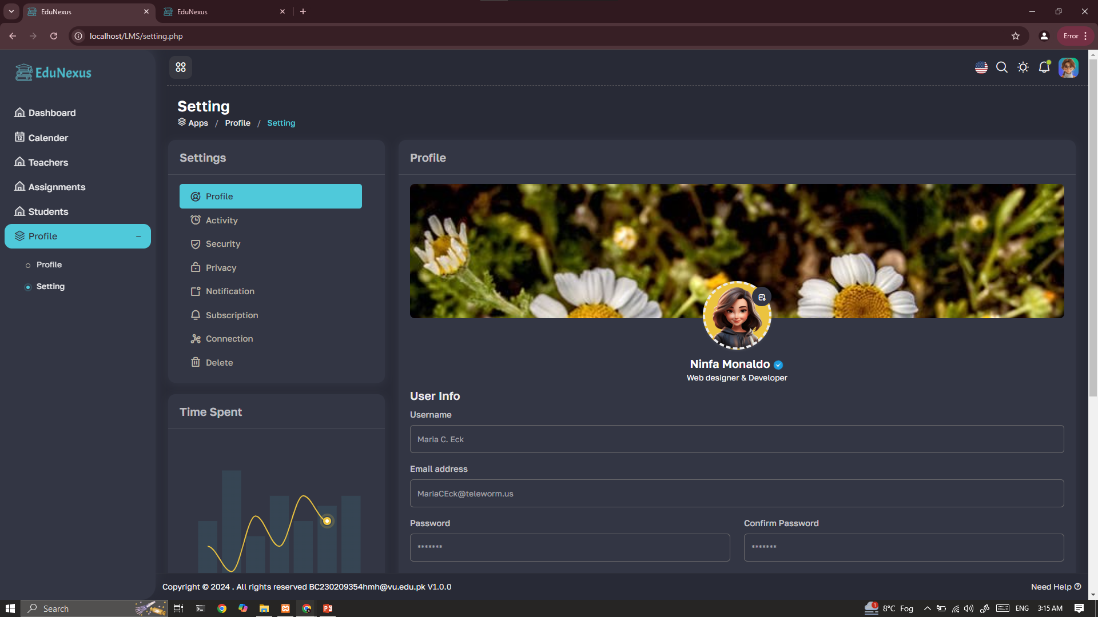

Slide 36
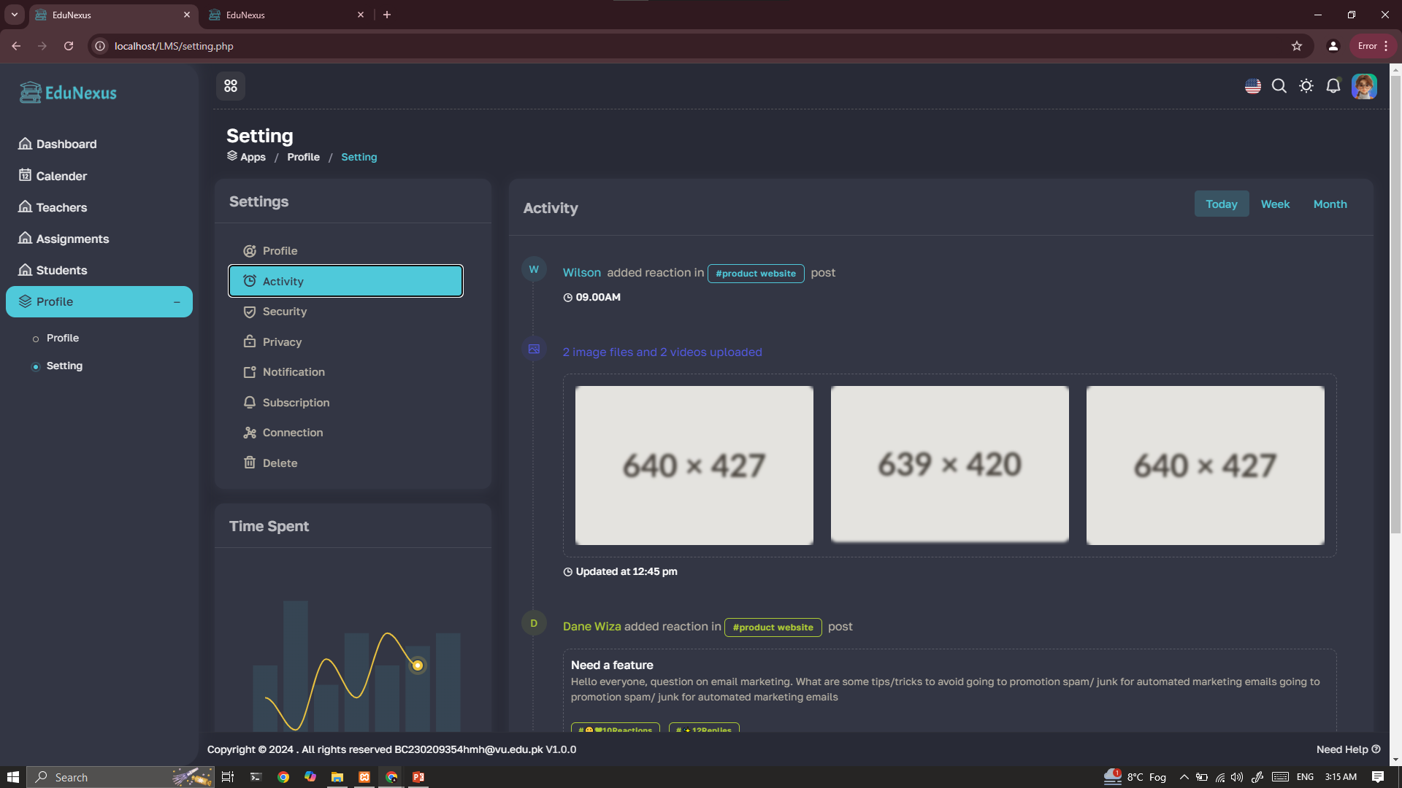

Slide 37
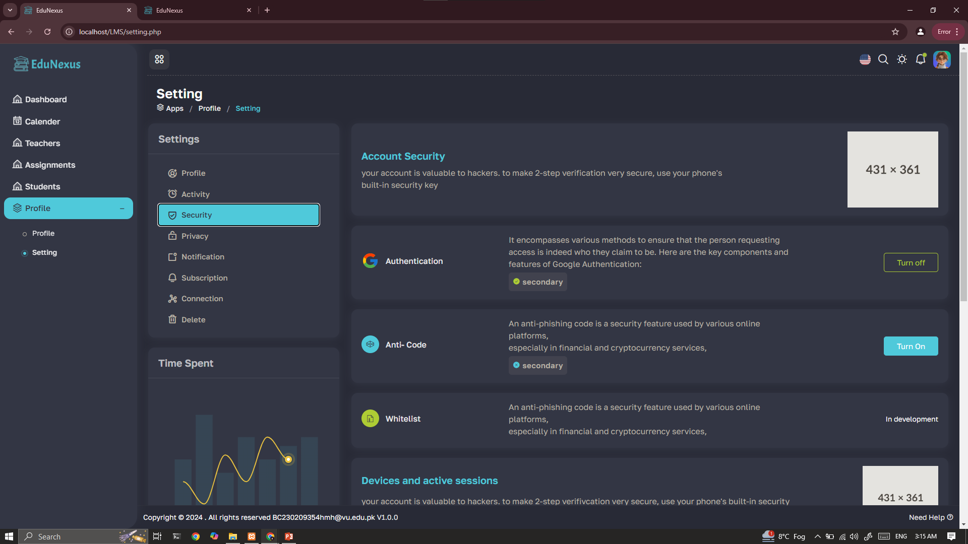

Slide 38
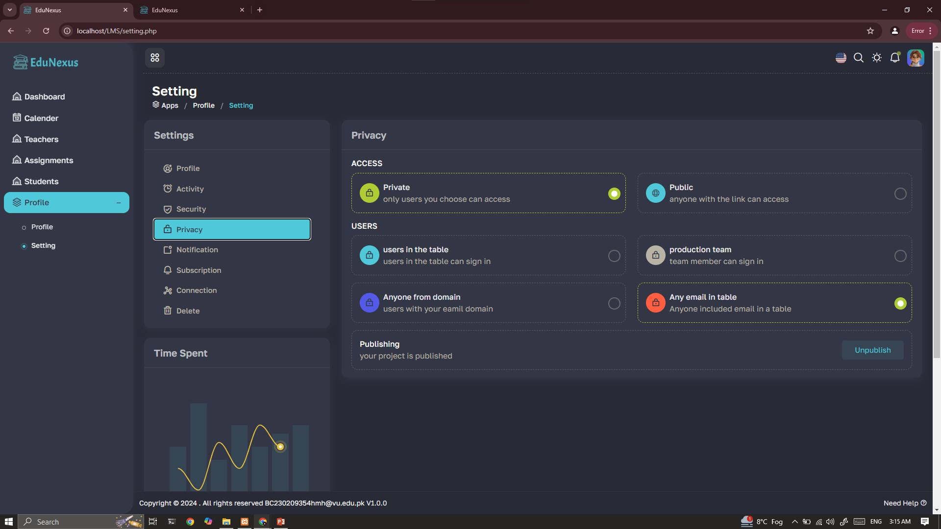

Slide 39
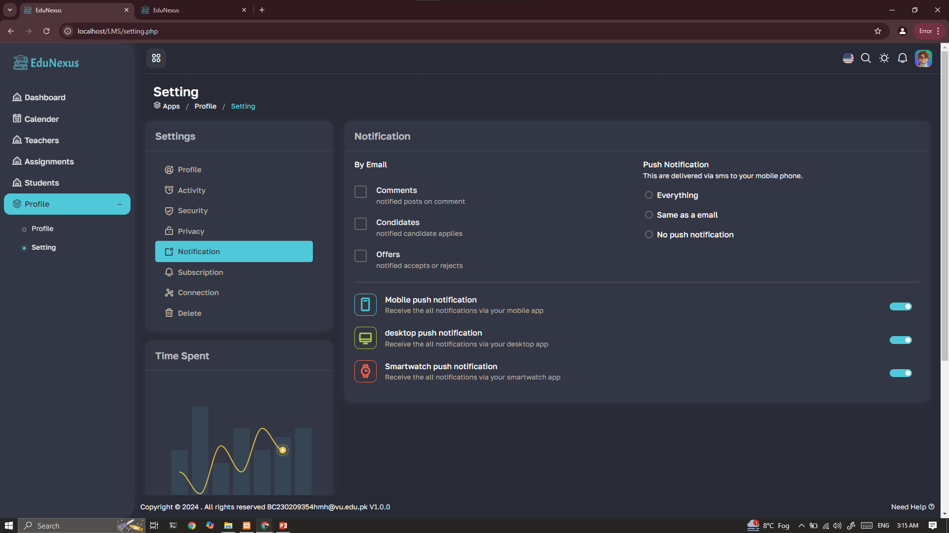

Slide 40
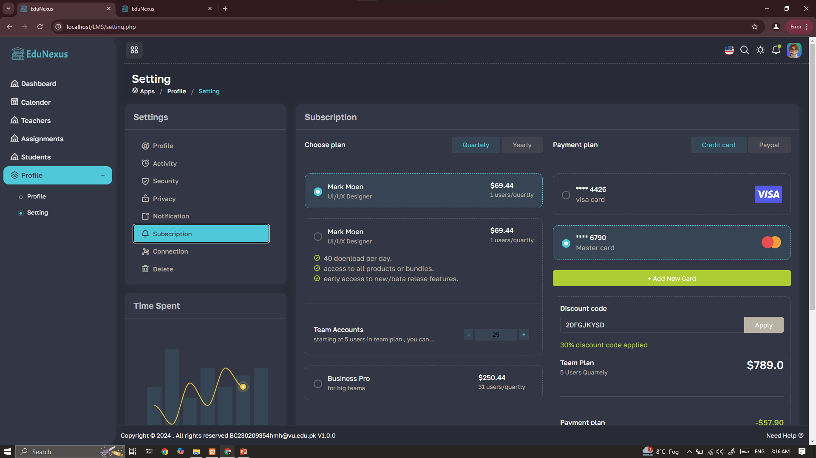

Slide 41
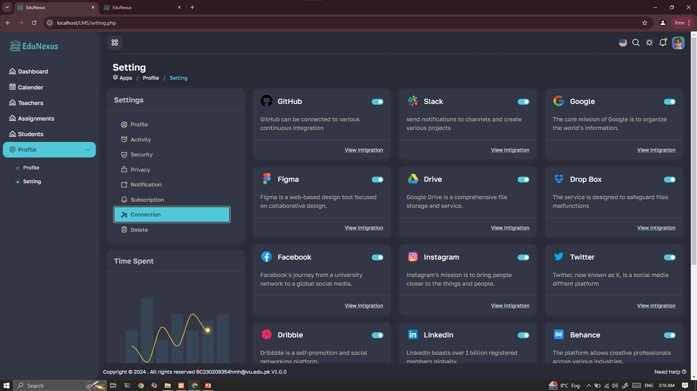

Slide 42
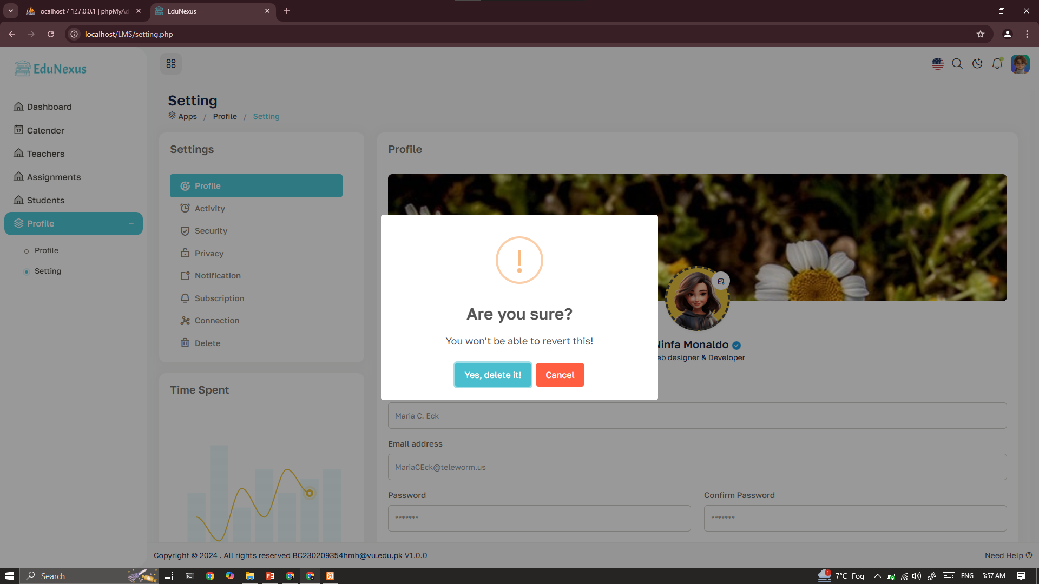

Slide 44
THANK YOU

